Slide 1


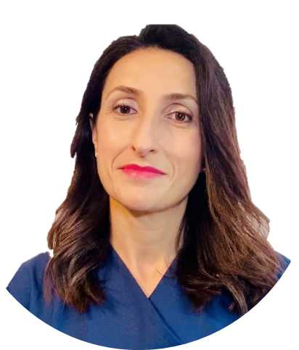
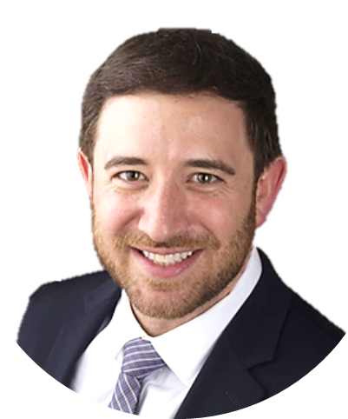
Thursday
Dec. 11, 2025
13:45-14:00pm
The Paris Vascular
Insights Course 2025
Agora Room, Carrousel du Louvre
Paris, France
Learning Objective:
Assess the newest clinical data from SUCCESS PTA and Japan SFA studies to inform real-world treatment decisions.
Explore how SELUTION SLR™ DEB technology and drug formulation support vascular healing.
Review clinical cases highlighting the impact of optimal vessel preparation in DEB outcomes.
Dr. Marta
Lobato Andrés
Spain
Dr. Eric Alexander Secemsky
USA
Faculty
Dr. Name
Country
Faculty
Dr. Name
Country
Faculty
Dr. Name
Country
Faculty
Dr. Name
Country
Faculty
Dr. Name
Country
Faculty
Dr. Name
Country

