Slide 1
First report of the 12-month data from the SUCCESS PTA study: Sirolimus DCB in real-world patients with peripheral arterial disease
Michael Lichtenberg
Vascular Centre Clinic Arnsberg

Slide 2
Disclosure
Speaker name: Michael Lichtenberg
I have the following potential conflicts of interest to report:
Receipt of grants/research support
Receipt of honoraria and travel support
Participation in a company-sponsored speaker bureau
Employment in industry
Shareholder in a healthcare company
Owner of a healthcare company
I do not have any potential conflict of interest

Slide 3
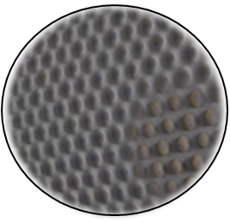
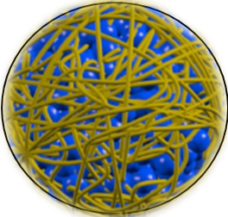
SELUTION SLR™ Drug Eluting Balloon Technology
2 key features define the
unique performance of SELUTION SLR™ DEB
CELL ADHERENT TECHNOLOGY (CAT)TM
Phospholipid blend containing and protecting MicroReservoirs at 1 μg/mm² Sirolimus dose¹
Enhanced Drug Transfer Efficiency
MicroReservoirs
∼4 µm spheres of Sirolimus mixed with biodegradable polymer¹
Sustained Drug Release
¹ Cordis Data on file

Slide 4
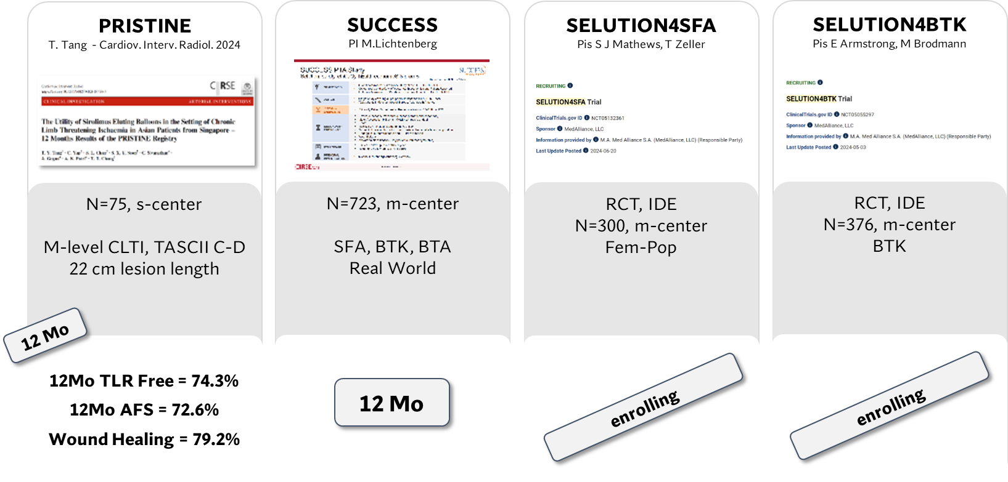
SELUTION SLR™ deb in PAD – Clinical Program Overview
Extensive clinical program consisting of 9 Studies and more than 1,800 patients
SFA/BTK
Real World
2 IDE RCTs
(SFA and BTK)
2 Proof-of-Concept
2 Complex SFA
2 Complex CLTI
12 Mo
First time
data release

Slide 5
SUCCESS PTA STUDY Study Overview
Objectives & Design
Global post-market surveillance study of the SELUTION SLR DEB (SFA, BTK, Foot)
Collect real world safety and efficacy data on the use of the SELUTION SLR DEB
723 patients in 27 sites around Europe, Asia and South America
Primary Endpoint: Clinically Driven Target Lesion Revascularization (CD-TLR) at 12M
Secondary Endpoints:
Device success & Procedure success
Major Adverse Limb Events (MALE) composite endpoint
Death
TLR & TVR - including time to first CD-TLR
Target limb revascularization, thrombosis at the target site and amputation
Change in Rutherford score, ABI from baseline and EQ5D
Follow-up:
Clinical Follow-up: 6 months, 1 year
Telephone Follow-up: 2, 3, 4, 5 years
PI: Michael Lichtenberg, Arnsberg, Germany

Slide 6
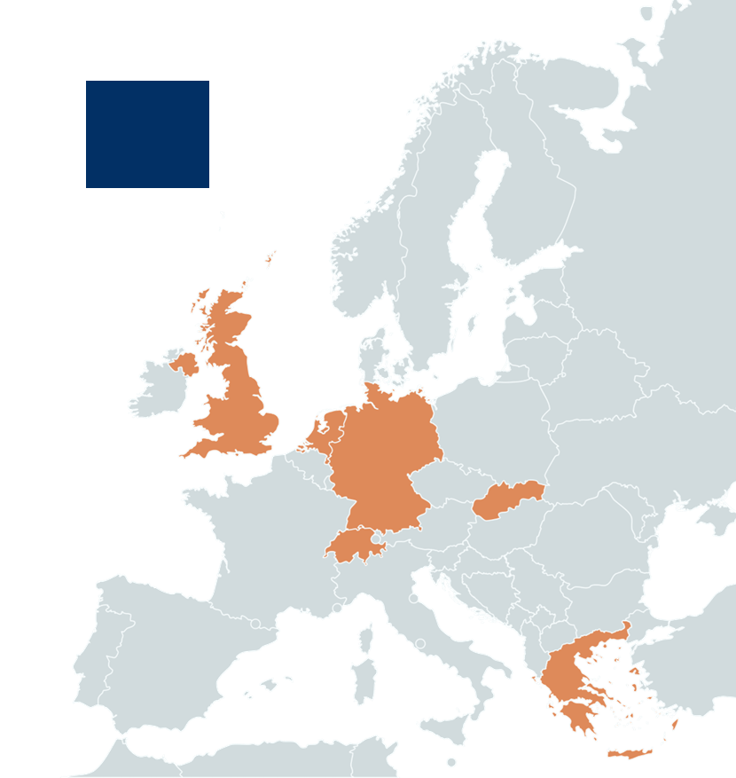
Germany
SUCCESS PTA STUDy 27 sites in 8 countries
• Klinikum Hochsauerland (Lichtenberg) • Universitätsklinikum Essen (Rammos)
• Universitätsklinikum Tübingen (Schmehl) • Universitätsklinikum Würzburg (Kickuth) • Krankenhaus Buchholz (Hertting) • GRN Klinik Weinheim (Korosoglou) • SRH Klinikum Karlsbad (Oberacker) • Medizinisches Versorgungszentrum GmbH (Schofer) • LMU Klinikum Großhadern München (Konstantinou) • DIAKO Krankenhaus (Müller-Hülsbeck) • University Heart Center Freiburg (Zeller) • Universitätsklinikum Heidelberg (Böckler)
United Kingdom
• Guy’s and St Thomas’ Hospital (Patel) • The Royal Hospital (Jaffer)
• Frimley Park Hospital (Taylor) • East Surrey Hospital (Heiss) •University Hospital Leicester (Kandiyil)
Singapore
• National University Hospital Singapore (Dharmaraj)
Netherlands
• ETZ Tilburg (Lohle)
Switzerland
• Kantonsspital Aarau (Gissler) • Luzerner Kantonsspital (Rastan)
• HUG Geneva (Glauser)
Slovakia
• Trnava University Hospital (Lebdušková)
Argentina
• Hospital Italiano de La Plata (Pascua)
Greece
• Attikon University Hospital (Brountzos) • General University Hospital of Patras (Katsanos) • Athens Medical Center (Bisdas)

Slide 7
SUCCESS PTA STUDY Patient flow chart
Enrolled Patients
N=723
Patients enrolled between:
Feb 2021 and Oct 2023
3 patients withdrew consent and did not approve to keep previously collected study data
Procedure
SELUTION SLRTM DEB
N=720
24 Deaths
41 Withdrawal
10 Lost to follow-up
16 Follow-up Visits Missed
12-month FU
Completed* N=653 (90.7%)
Completed° (inside the window) N=558 (77.5%)
* Patients who completed the 12-month FU visit at anytime or deaths
° Patients who completed the FU visit inside the window (365 ± 30 days)
Notes:
1Y FU total: N=629 (87.4%)
1Y inside the window: N=534 (74.2%)

Slide 8
SUCCESS PTA STUDY Baseline patient characteristics
 | Full Cohort (N = 720 patients) | Claudicants (N = 534 patients) | CLTI (N = 186 patients)
Age (years) | 70.7 ± 9.9 | 70.0 ± 9.6 | 72.8 ± 10.3
Male | 65.0% | 63.9% | 68.3%
Diabetes Mellitus | 37.9% | 33.0% | 52.2%
Insulin Dependent | 13.6% | 9.4% | 25.8%
Previous Interventionª (<1 Year) at lesion | 16.6% | 14.8% | 21.5%
Hypertension | 85.3% | 84.5% | 87.6%
Hyperlipidemia | 76.8% | 77.0% | 76.3%
Cerebral stroke/TIA | 7.1% | 5.6% | 11.3%
Myocardial Infarction | 14.9% | 15.0% | 14.5%
Renal Failure/Impairment | 16.8% | 12.7% | 28.5%
Current smoker^{b} | 30.3% | 31.8% | 26.3%
Rutherford Class 1 | 3.2% | 4.3% | 0%
Rutherford Class 2 | 21.4% | 28.8% | 0%
Rutherford Class 3 | 49.4% | 66.7% | 0%
Rutherford Class 4 | 8% | 0% | 31.2%
Rutherford Class 5 | 16.5% | 0% | 64%
Rutherford Class 6 | 1.2% | 0% | 4.8%
Denominator
ª718 full cohort; 532 claudicants
^{b}715 full cohort; 529 claudicants

Slide 9
SUCCESS PTA STUDY Baseline patient characteristics
 | Full Cohort (N = 720 patients) | Claudicants (N = 534 patients) | CLTI (N = 186 patients)
Age (years) | 70.7 ± 9.9 | 70.0 ± 9.6 | 72.8 ± 10.3
Male | 65.0% | 63.9% | 68.3%
Diabetes Mellitus | 37.9% | 33.0% | 52.2%
Insulin Dependent | 13.6% | 9.4% | 25.8%
Previous Interventionª (<1 Year) at lesion | 16.6% | 14.8% | 21.5%
Hypertension | 85.3% | 84.5% | 87.6%
Hyperlipidemia | 76.8% | 77.0% | 76.3%
Cerebral stroke/TIA | 7.1% | 5.6% | 11.3%
Myocardial Infarction | 14.9% | 15.0% | 14.5%
Renal Failure/Impairment | 16.8% | 12.7% | 28.5%
Current smoker^{b} | 30.3% | 31.8% | 26.3%
Denominator
ª718 full cohort; 532 claudicants
^{b}715 full cohort; 529 claudicants
26% CLTI
Rutherford
classification

Slide 10
SUCCESS PTA STUDY Baseline lesion characteristics
 | Full Cohort 821 lesions | ATK * 756 lesions (92%) | BTK * 65 lesions (8%)
RVD (mm) | 5.2 ± 1.5 | 5.3 ± 0.9 | 3.1 ± 0.9
Lesion Length (mm) | 128.4 ± 101.8 | 130.5 ± 103.3 | 104.1 ± 77.7
De novo Lesion | 75.0% | 74.7% | 78.5%
Diameter stenosis (%) | 91.6 ± 11.2 | 91.6 ± 11.0 | 91.3 ± 14.2
Total occlusion | 42.1% | 41.9% | 44.6%
MLD (mm) | 1.0 ± 2.1 | 1.0 ± 1.9 | 0.4 ± 0.6
Calcification Grade 3ª | 20.0% | 20.3% | 16.9%
Calcification Grade 4ª | 16.3% | 16.8% | 10.8%
Provisional stenting | 32.0% (263) | 33.9% (256) | 10.8% (7)
Residual Stenosis > 30% | 47.5% (125/263) | 47.6% (122/256) | 42.8% (3/7)
Flow limiting dissection | 45.6% (120/263) | 45.7% (117/256) | 42.8% (3/7)
Other | 11.4% (30/263) | 11.3% (29/256) | 14.4% (1/7)
Final residual stenosis (%) | 10.0 ± 10.4 | 10.1 ± 9.9 | 9.6 ± 14.6
Denominator
ª820 full cohort; 755 ATK
* Target lesion location defined as ATK (above P3) and BTK (below P2)
** One lesion can cross multiple segments
BTK Segment Location **
POP 3 | 11 / 65
Anterior Tibial Artery | 26 / 65
Posterior Tibial Artery | 15 / 65
Peroneal Artery | 12 / 65
TP Trunk | 7 / 65

Slide 11
SUCCESS PTA STUDY Procedural characteristics
 | Full Cohort (N = 720 patients) | ATK (N = 668 patients) | BTK (N = 52 patients)
Lesion preparation | 98.8% (803/813**) | 98.7% (745/755**) | 100% (58/58**)
Device type for lesion preparation
POBA | 71.6% (791/1104*) | 70.8% (728/1028*) | 82.9% (63/76*)
Atherectomy/Thrombectomy | 19% (210/1104*) | 19.8% (204/1028) | 7.9% (6/76*)
Scoring Balloon | 3.0% (33/1104*) | 2.8% (29/1028*) | 5.3% (4/76*)
Cutting Balloon | 1.5% (17/1104*) | 1.7% (17/1028*) | 0.0% (0/76*)
IVL | 2.3% (25/1104*) | 2.1% (22/1028*) | 3.9% (3/76*)
Device Success | 99.0% (1294/1307*) | 99.0% (1214/1226*) | 98.8% (80/81*)
Procedure Success | 97.9% (705/720) | 97.9% (654/668) | 98.1% (51/52)
Device Success: Successful delivery, balloon inflation, deflation and retrieval of the intact study device without burst below rated burst pressure.
Procedure Success: Device success and residual stenosis ≤ 50% at the end of the procedure.
*Total number of devices
**Total number of lesions

Slide 12
SUCCESS PTA STUDY
Freedom from CD-TLR up to 365 days - KM curves
91.1% Full Cohort
91.3% Claudicants
90.3% CLTI
365
Full Cohort

Slide 13
SUCCESS PTA STUDY Clinical outcomes up to 365 days
Clinical Outcomes up to 365 days | Full Cohort N = 720 | Claudicants N = 534 | CLTI N = 186
Death | 3.5% (23/652) | 1.2% (6/501) | 11.3% (17/151)
Major Cardiac Event* | 2.7% (17/636) | 2.2% (11/497) | 4.3% (6/139)
CD-TLR | 9.0% (57/631) | 8.7% (43/496) | 10.4% (14/135)
Thrombosis | 0.8% (5/629) | 0.4% (2/495) | 2.2% (3/134)
Target limb amputation | 2.2% (14/634) | 0.2% (1/496) | 9.4% (13/138)
Major target limb amputation | 1.4% (9/633) | 0.2% (1/496) | 5.8% (8/137)
Minor target limb amputation | 0.8% (5/630) | 0.0% (0/495) | 3.7% (5/135)
MALE* | 13.3% (85/638) | 11.6% (58/498) | 19.3% (27/140)
*Major cardiac event: MI, stroke, cardiovascular death
*MALE: Severe limb ischemia leading to an intervention to target limb or major vascular amputation

Slide 14
SUCCESS PTA STUDY
Rutherford classification up to 12-month FU (paired analysis°)
Full Cohort (N=507) Claudicants (N=408) CLTI (N=99)
* p-value < 0.0001
* p-value < 0.0001
* p-value < 0.0001
° Based on patients who had baseline and 12-month FU available (FU performed inside the window).

Slide 15
SUCCESS PTA STUDY ABI up to 12-month FU (paired analysis°)
Full Cohort Claudicants CLTI
(N=366) (N=307) (N=59)
0.9±0.2
0.9±0.3
0.9±0.2
0.9±0.3
0.9±0.2
0.9±0.3
0.7±0.3
0.7±0.2
0.6±0.3
Baseline 6M 12M
Baseline 6M 12M
Baseline 6M 12M
* p-value < 0.0001
* p-value < 0.0001
* p-value < 0.0001
Improvement at 6 months is maintained out to 12 months
° Based on patients who had baseline, 6-month and 12-month FU available (FU performed inside the window).

Slide 16
SUCCESS PTA STUDY EQ5D at 12-month FU (paired analysis°)
Extreme problems
Severe problems
Moderate problems
Slight problems
No problem
Baseline
12M
Baseline
12M
Baseline
12M
Baseline
12M
Baseline
12M
Mobility
(n=506)
Self-Care
(n=506)
Usual Activities
(n=506)
Pain/Discomfort
(n=504)
Anxiety/Depression
(n=506)
 | Baseline N = 499 | 6-month N = 499 | 12-month N = 499 | P-value (% change) Baseline-12M
EQ-VAS Score | 63.1 ± 18.3 | 71.8 ± 18.3 | 70.1 ± 19.8 | <0.001
Improvement at 6 months
is maintained
out to 12 months
° Based on patients who had baseline and 12-month FU available (FU performed inside the window).

Slide 17
SUCCESS PTA STUDY Data in context - 12-month FU
12Mo Freedom from CD-TLR
 | SUCCESS PTA Registry | In.Pact Global Registry ¹ | Ranger Registry ² | Biolux PIII Registry ³
Sample size | 720 | 1406 | 172 | 700
RCC 4 | 8% | 8% | 8% | 11%
RCC 5 | 16% | 3% | 5% | 21%
RCC 6 | 1% | 0% | 1% | 6%
Diabetic | 38% | 40% | 35% | 47%
BTK involvement | 8% | 0% | 0% | 11.9%
Provisional Stenting | 32% | 21% | 22% | 17%
Zeller, et al. Circ Cardiovasc Interv. 2019
Lichtenberg, et al. Journal of Cardio Surg 2018
Tepe, et al. Journ Endovasc Therapy 2020

Slide 18
SUCCESS PTA STUDY Conclusions
The SUCCESS PTA is a multi-center, real-world registry with more than 700 patients with claudication and CLTI treated with SELUTION SLR™ DEB.
Positive 12-month outcomes with consistent hemodynamic, functional, and clinical improvement associated with 91.1% freedom from CD-TLR overall and 90.3% for the CLTI subgroup.
The 12-month results continue to demonstrate consistency of positive results across SELUTION SLR™ DEB trials.
Largest study of a Sirolimus drug-eluting balloon in a complex PAD patient cohort with outcomes comparable to previous DCB registries.

