Slide 1
36-month results from SELUTION SFA Japan trial
Safety and efficacy of a novel sirolimus-coated balloon
for the treatment of femoropopiteal lesions in Japanese population
Osamu Iida¹⁾, Yoshimitus Soga²⁾
1) Osaka Keisatsu Hospital, Cardiovascular Division
2) Kokura Memorial Hospital, Department of Cardiology

Slide 2
Disclosure
Speaker Name: Osamu Iida, MD, PhD
-------------------------------------------------------------------------------------------------
I have the following potential conflicts of interest to report:
Consulting: Abbott, Boston Scientific, Gore Medical, Kaneka Medix, Tokai Medical, Nipro, Orbus Neich, Otsuka medical
Employment in industry:
Stockholder of a healthcare company:
Owner of a healthcare company:
Others (Honoraria): Boston Scientific, Canon, Cordis Japan, Gore Medical, Kaneka Medix, Tokai Medical, Orbus Neich, Otsuka medical Medtronic, Terumo,
I do not have any potential conflict of interest

Slide 3
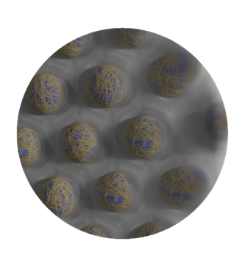
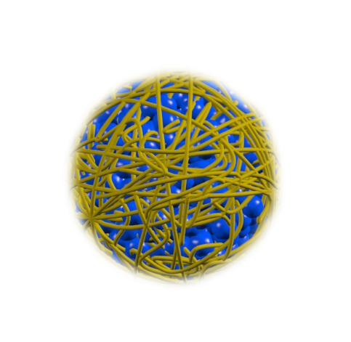
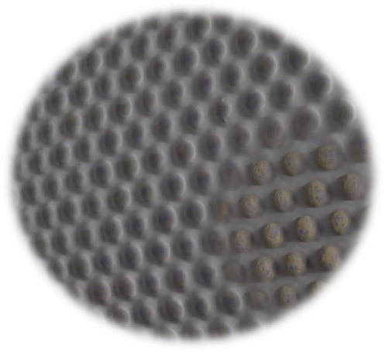
Background 1 | A Novel Sirolimus-coated Balloon
SELUTION SLR™ Drug Coated Balloon
Proprietary MicroReservoir Technology
Creation of MicroReservoirs combining sirolimus & biodegradable polymer
Sirolimus - a proven safe & effective cytostatic drug
Offering a wider therapeutic range
MicroReservoirs: Miniature Drug-Delivery
Consistent and predictable drug release
Optimal size MicroReservoirs to achieve pharmaco- kinetic release profile comparable to best-in-class DES
Sustained therapeutic effect for up to 90 days
Cordis data on file
CELL ADHERENT TECHNOLOGY (CAT)™
Proprietary phospholipid technology which binds MicroReservoirs to the balloon surface
Contains and protects micro-reservoirs during insertion and inflation
Enhances drug retention and bioavailability, allowing for a lower drug dose concentration on the balloon surface (1 μg/mm²)
Optimizes transfer of MicroReservoirs to the tissue and maximizes the cellular uptake of sirolimus

Slide 4
Background 2 | SELUTION SLR™ DCB in PAD- Clinical Program
Extensive program consisting of 9 Studies and more than 1,800 patients
Proof-of-Concept
SELUTION FIM | Zeller T. J Endovasc Ther 2020 | n=50 | S-center | Fem-pop | RC 2-3 | LL: 6.3cm | 24mo
LIMUS Flow | Rammos C. LINC 2024 | n=70 | S-center, RCT SELUTION vs. IN.PACT | Fem-pop | RC 2-4 |  | 12mo
Complex SFA
Selution SFA | Iida O. JET 2024, JACC CI 2024 | n=134 | M-center | Fem-pop | RC 2-4 | LL: 12.7cm | 12mo
Selution SFA IT | Franzese M. J Endovasc Ther 2023, Cioppa A. LINC 2024 | n=80 | S-center | Fem-pop | RC 2-4 | LL: 17.1cm | 24mo
Chronic limb-threatening ischemia
PRESTISE | Tang T. VIVA 2022 | n=25 | S-center | BTK, TASC II C-D | CLTI | LL: 18cm | 24mo
PRISTINE | Tang T. Cardiovasc Intervent Radiol 2024 | n=75 | M-center | TASC II C-D | M-level CLTI | LL: 22cm | 12Mo
SFA/BTK Real World
SUCCESS | Lichtenberg M | n=723 | M-center | SFA, BTK, BTA |  |  | 12Mo
RCTs SFA/BTK
Selution4SFA | Mathews SJ, Zeller T. | n=300 | M-center, RCT, IDE | Fem-pop |  |  | enrolling
Selution4BTK | Armstrong E, Brodmann M | n=376 | M-center, RCT, IDE | BTK |  |  | enrolling
SELUTION SFA Japan: 36-Month Data Released for the First Time

Slide 5
Method 1 | Study Overview of SELUTION SFA Japan
 | Objective | Assess the safety and efficacy of SELUTION SLR™ DEB (Cordis/MedAlliance) for the endovascular therapy of de novo and non-stented restenotic lesions in the superficial femoral artery (SFA) and the popliteal artery (PA)
 | Study design | Prospective, multi-center, single arm trial
 | Study subject | 134 patients enrolled at 13 sites in Japan
 | Primary endpoint | 12-month primary patency of the target lesion *Primary patency defined as freedom from clinically driven TLR and freedom from restenosis as determined by DUS
 | Core laboratory and monitoring | Independent and duplex Ultrasound Core Lab^{[1]}, Angiographic Core Lab^{[1]}, and Clinical Events Committee^{[2]}, External Monitoring, 100% Source Data Verification
Japan Endovascular Treatment Conference, Fukuoka city, Kyushu Japan;
Clinical Events Committee and Data Safety Monitoring services provided by individula comittee (IC, VS, IR)

Slide 6
Method 2 | Investigators and Sites
Name of Institution | Principal Investigator | Number of enrollment
Kokura Kinen Hospital | Dr. Kenji ANDO/Dr. Yoshimitsu SOGA* | 30
Shonan Kamakura General Hospital | Dr. Shigeru SAITO | 17
Kansai Rosai Hospital | Dr. Toshiaki MANO/Dr. Osamu IIDA* | 16
Asahi General Hospital | Dr. Naoki HAYAKAWA | 13
Nara Medical University Hospital | Dr. Shigeo ICHIHASHI | 13
Morinomiya Hospital | Dr. Daizo KAWASAKI | 10
Tokyo Saiseikai Central Hospital | Dr. Kenji SUZUKI | 8
Matsuyama Red Cross Hospital | Dr. Terutoshi YAMAOKA | 8
Kishiwada Tokushukai Hospital | Dr. Masahiko FUJIHARA | 6
Tokyo Bay Urayasu Ichikawa Medical Center | Dr. Tatsuya NAKAMA | 5
Toho University Ohashi Medical Center | Dr. Masato NAKAMURA | 4
Sendai Kosei Hospital | Dr. Norio TADA | 2
Saiseikai Nakatsu Hospital | Dr. Amane KOZUKI | 2
* Principal Investigators

Slide 7
Method 3 | Inclusion/Exclusion Criteria
Key Inclusion Criteria
1. Patients with Rutherford classification of 2-4.
2. Patients with target lesion in superficial femoral artery (SFA) to popliteal artery (PA)
De novo or restenotic lesions with >70% and <100% stenosis Lesion length ≤ 200 mm RVD of ≥ 3.0 mm and ≤ 7.0 mm Tandem lesions allowed if the above criteria was met and lesion gap $≤$3 cm
4. Adequate distal run-off to the foot
Key Exclusion Criteria
Patients with target vessel acute or subacute thrombosis
MI $≤$ 30 days before the index procedure
Hemorrhagic Stroke $≤$ 3 months
Any major surgical procedures performed 15 days before of planned 30 days after index procedure
Previous treatment with DCB or DES in the lower limbs
Patients with severe renal failure (GFR less than 30 mL/min) or patients undergoing dialysis

Slide 8
Method 4 | Statistical Assumptions
Assumptions for Primary Patency at 12 month
Non-coated balloon angioplasty [Historical control]: 60% Based on the upper limit of the two-sided 95% CI derived from historical data from DCB randomized trials (54.3% [CI: 49.2%-59.3%])
SELUTION SLR DCB arm: 75%
Sample size of 132 patients provides
90% power
To demonstrate that the lower bound of 95% CI with SELUTION DEB > POBA of 60%
Assumes 15% loss to follow-up (at least 112 evaluable patients required)

Slide 9
Results 1 | Patient Flow Chart
Procedure
SELUTION SLRTM DEB
Patients N = 134
5 Deaths
12M Follow-up
Completed N = 129 (96.3% Clinical FU)
1 Death
2 lost to follow-up
3 patients withdrew
24M Follow-up
Completed N = 123 (91.8% Clinical FU)
5 Deaths
5 lost to follow-up
3 patients withdrew
36M Follow-up
Completed N = 110 (82.1% Clinical FU)
36M Follow-up
Completed clinical follow up or died N = 121 (90.3% FU)

Slide 10
Results 2 | Patient and Lesion Characteristics
Patient Characteristics | N=134
Age, (Y ± SD) | 73.8 ± 6.9
Male % (n) | 81.3% ( 109 )
Diabetes Mellitus % (n) | 60.3% ( 79 )
Insulin Dependent Diabetes Mellitus % (n) | 12.7% ( 10 )
Dyslipidemia % (n) | 78.6% ( 103 )
Hypertension % (n) | 90.1% ( 118 )
Current Smoker % (n) | 28.4 % ( 38 )
Chronic Renal Insufficiency % (n) | 6.9% ( 9 )
Prior Cardiovascular Disease % (n) | 54.3% ( 44 )
Cerebrovascular Disease % (n) | 22.2% ( 18 )
Rutherford Category % (n)
2 | 36.6% ( 49 )
3 | 61.2% ( 82 )
4 | 2.2% ( 3 )
ABI | 0.73 ± 0.16
Lesion Characteristics | N=134
De novo Lesions % (n) | 98.5% ( 132 )
Lesion Length (mm ± SD) | 127.4 ± 59.7
Reference Vessel Diameter (mm ± SD) | 5 ± 0.9
Diameter Stenosis % (n) | 68.4 ± 20.6
Total Occlusions % (n) | 17.2 % ( 23 )
Patients with Popliteal Involvement % (n) | 47.8% ( 64 )
TASC Classification % (n)
TASC A | 48.5% ( 65 )
TASC B | 38.1% ( 51 )
TASC C | 12.7% ( 17 )
TASC D | 0.7% ( 1 )
PACSS Calcification % (n)
Grade 3 | 15.7% ( 21 )
Grade 4 | 11.2% ( 15 )

Slide 11
Results 3 | Procedural Characteristics
Procedural Characteristics | N= 134
Pre-dilatation % (n) | 100% ( 134 )
Post-dilatation % (n) | 5.2% ( 7 )
Treatment Length with SELUTION DCB (mm) | 170.2 ± 57.0
Patients receiving more than 1 device % (n) | 59% ( 79 )
Aneurysm* % (n) | 0% ( 0 )
Perforation* % (n) | 0% ( 0 )
Peripheral Embolization* % (n) | 2.3% ( 3 )
Dissections* % (n)
None | 61.9 % ( 83 )
A-C | 35% ( 47 )
D | 2.2% ( 3 )
E | 0.7% ( 1 )
F | 0% ( 0 )
Procedural Characteristics | N= 134
Bailout stenting % (n) | 1.5% ( 2 )
Final Residual Stenosis (%) | 20.4 ± 11.8
Device Success ¹ % (n) | 100% ( 134 )
Procedural Success ² % (n) | 96.3% ( 129 )
Clinical Success ³ % (n) | 96.3% ( 129 )
* Per Core Laboratory assessment
¹ Device success: successful insertion, expansion, contraction, retrieval of the investigational device
² Procedural success: residual target lesion stenosis of 30% or less on visual inspection
³ Clinical success: absence of MAE within 24 hours of the study procedure

Slide 12
Results 4 | Primary Endpoint – 36M Primary Patency
100
12 Months
87.9%
75
24 Months
83.2%
36 Months*
81.5%
End of follow up window (36+1M)
80.6%
50
Primary Patency (%)
25
0
0
365
730
1095
Days after procedure
Days | 0 |  | 365 |  | 730 |  | 1095 |  | 1125
No. at risk | 134 |  | 115 |  | 102 |  | 92 |  | 91
* Cutoff date is set to 1125 days (relevant evaluation period of 1095 days + 30 days)

Slide 13
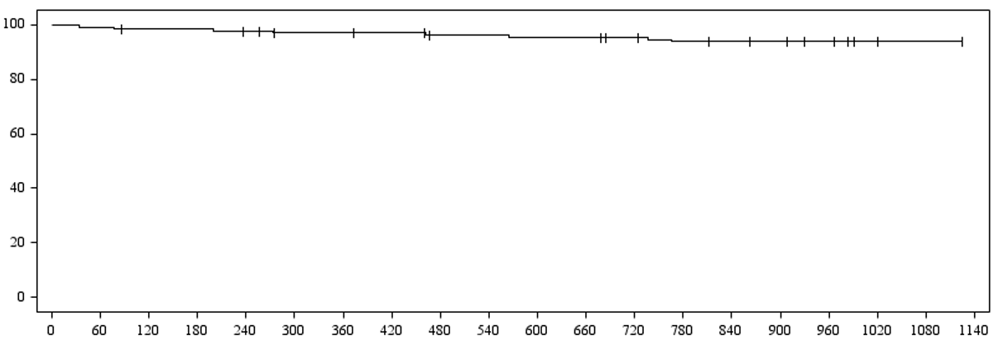
Results 5 | Secondary Endpoint – 36M Freedom from TLR
100
End of follow up window (36+1M)
93.8%
75
12 Months
97.0%
24 Months
95.4%
36 Months*
93.8%
50
Primary Patency (%)
25
0
0
365
730
1095
Days after procedure
Days | 0 |  | 365 |  | 730 |  | 1095 |  | 1125
No. at risk | 134 |  | 126 |  | 118 |  | 108 |  | 108
* Cutoff date is set to 1125 days (relevant evaluation period of 1095 days + 30 days)

Slide 14
Results 6 | Safety and Efficacy Clinical Outcomes
 | 12 Months | 24 Months | 36 Months
Efficacy Endpoints* (KM Estimates)
Primary Patency | 87.9% 95% CI: 81.0-92.4 | 83.2 % 95% CI: 75.7-88.6 | 81.5 % 95% CI: 73.7-86.5
Freedom from TLR | 97.0% 95% CI: 92.2-98.9 | 95.4 % 95% CI: 90.1- 97.9 | 93.8 % 95% CI: 88.0-96.9
Safety Endpoints**
CD-TVR | 3.0% (4) | 6.7% (9) | 7.5% (10)
Thrombus in target lesions | 0.7% (1) | 0.7% (1) | 0.7% (1)
Major Adverse Events | 6.7% (9) | 9.7% (13) | 14.2% (19)
Target limb amputation | 0.0% (0) | 0.0% (0) | 0.0% (0)
All-cause death | 3.7% (5) | 4.5% (6) | 8.2% (11)
CD-TLR | 3.0% (4) | 5.2% (7) | 6.0% (8)
* Cutoff date is set to 1125 days (relevant evaluation period of 1095 days + 30 days)
** Inclusion of events from the day of procedure to the reference date of the relevant evaluation period + 30 days

Slide 15
Results 7 | Rutherford Classification
Paired analysis based on 110 patients who have all the time points available
Improvements in Rutherford categories are maintained
out to 36 months
RCC 4
RCC 3
RCC 2
RCC 1
RCC 0

Slide 16
Results 8 | Improvements in ABI Maintained up to 36 Months
Paired analysis based on 101 patients who have all the time points available
Improvements in ABI are maintained out to 36 months

Slide 17
Discussion | 36-Months Results of Paclitaxel versus Sirolimus DCB
 | IN.PACT PCB (3.5 µg/mm²) | Ranger PCB (2 µg/mm²) | SELUTION SLR SCB (1µg/mm²)
Pivotal study title in Japan | MDT-2113 SFA Japan¹ (n=68) | Ranger SFA II Global² (n=278) | SELUTION SFA Japan(n=134)
Age (Years) | 73.3 ± 7.4 | 70.6 ± 9.5 | 73.8 ± 6.9
Diabetes mellitus, % (N) | 58.8% (40) | 42.4% (118) | 60.3% ( 79 )
ABI before index procedure | 0.76 ± 0.15^{b} | 0.8 ±0.2 | 0.73 ± 0.16
Rutherford Class 2 and 3, % (N) | 95.6% (65) | - | 97.8% (131)
Popliteal involvement , % (N) | 1.5% (1) | 5.4% (15) | 48% (64)
Severe calcification, % (N) | 7.4% (5) | 11.5% (32) | 11.2% (15)
PACSS calcification, grade 3 and 4, % (N) | - | 47.8% | 26.9% (36)
Lesion Length (mm)^{d} | 91.5 ± 58.5 | 82.5 ± 48.9 | 127.41 ± 59.73
Chronic total occlusions, % (N)^{d} | 16.2% (11) | 18.3% (133) | 17.2% (23)
RVD (mm)^{d} | 4.8 ± 0.8 | 5.1 ± 0.9 | 4.95 ± 0.93
36-month primary patency, % | 68.9% | 73.4% | 81.5%
36-month freedom from CD-TLR, % | 84.4% | - | 93.8%
Soga Y, Iida O, et al. J Endovasc Ther. 2020;27:946-955.
Brodmann M, Oral Presentation LINC 2023

Slide 18
Conclusions
This is the 1st report of the 36-month outcomes of SELUTION SLR™ drug-eluting balloon in a real-world population currently treated with DCB in Japan.
Excellent clinical outcomes, showing sustained benefits for patients over the long term
36-month primary patency was 81.5% and freedom from CD-TLR was 93.8%.
Improvement in Rutherford classification and ABI are maintained up to 36-month
Studies in Europe and Japan confirm consistent results, demonstrating that the SELUTION SLR™ sirolimus DCB is a safe and effective option for treating patients with femoropopliteal disease.

Slide 19
Osamu Iida, MD, PhD, FACC

