Slide 1

First report of the 24-month data from the SUCCESS PTA study: Sirolimus DEB in real-world peripheral artery disease patients
Michael Lichtenberg, MD Klinikum Hochsauerland, Arnsberg, Germany

Slide 2
Disclosure
Speaker name: Michael Lichtenberg, MD
I have the following potential conflicts of interest to report:
Receipt of grants/research support
Receipt of honoraria and travel support
Participation in a company-sponsored speaker bureau
Employment in industry
Shareholder in a healthcare company
Owner of a healthcare company
I do not have any potential conflict of interest

Slide 3
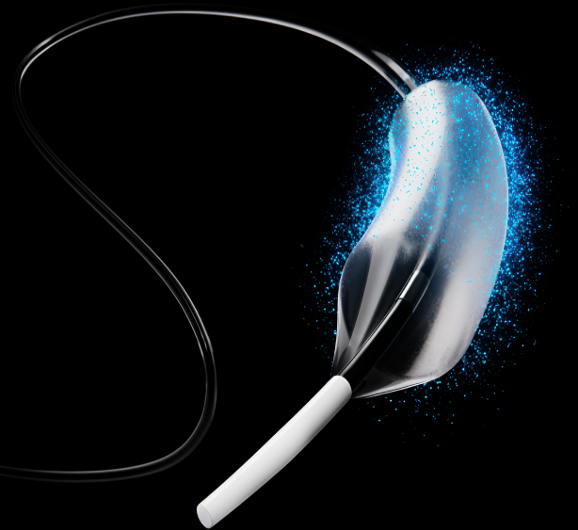
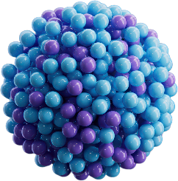
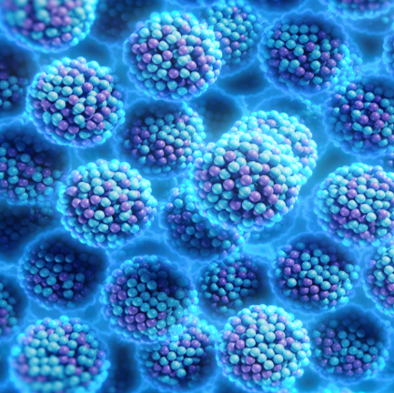
SELUTION SLR™ Drug-Eluting Balloon (DEB) Technology
2 key features define the
unique performance of SELUTION SLR™ DEB
MicroReservoirs
∼4 µm spheres of sirolimus mixed with biodegradable polymer
Controlled release of sirolimus
Proprietary Phospholipid Blend Coating
Phospholipid blend containing and protecting MicroReservoirs at 1 μg/mm² sirolimus dose
Enhances drug transfer efficiency
Cordis 2023 Data on file.
SELUTION SLRTM PTA DEB is approved in the United States for Investigational Use Only. Not available for Commercial Sale in the US.

Slide 4

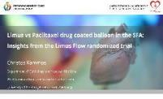

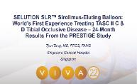

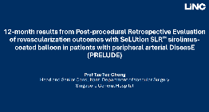
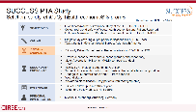
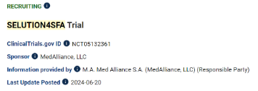
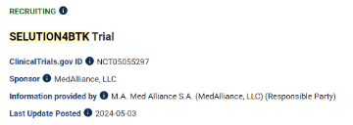
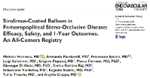
SELUTION SLR™ deb in PAD – Clinical Program Overview
Extensive clinical program consisting of 10 Studies and more than 1,900 patients
SFA/BTK
Real World
2 IDE RCTs (SFA and BTK)
2 Proof-of-Concept
2 Complex SFA
3 Complex CLTI
SELUTION FIM
T.Zeller - J Endovasc Ther. 2020
LIMUS FLOW
C.Rammos – LINC 2024
SELUTION SFA Japan
O. Iida - JET 2025
O.Iida - JACC CI 2024
SELUTION SFA IT
M.Franzese - J Endovasc Ther. 2023
A.Cioppa – LINC 2024
PRESTIGE
T. Tang, - VIVA 2022
PRISTINE
T. Tang - Cardiov. Interv. Radiol. 2024
PRELUDE
T. Chong – LINC 2026
SUCCESS
M.Lichtenberg - CX 2025
SELUTION4SFA
PIs S J Mathews, T Zeller
SELUTION4BTK
PIs E Armstrong, M Brodmann
N=50, s-center
Fem-pop, RC 2-3
6.3 cm lesion length
N=70, s-center RCT SELUTION vs. IN.PACT
Fem-pop,
RC 2-3-4
N=134, m-center
Fem-pop,
RC 2-3-4
12.7 cm lesion length
N=80, s-center
Fem-pop,
RC 2-3-4
17.1 cm lesion length
N=25, s-center
BTK CLTI,
TASC II C-D
18 cm lesion length
N=75, s-center
M-level CLTI,
TASC II C-D
22 cm lesion length
N=158, s-center
M-level CLTI,
TASC II C-D
17.6 cm lesion length
N=723, m-center
SFA, BTK, BTA
Real World
RCT, IDE
N=300, m-center
Fem-Pop
RCT, IDE
N=376, m-center
BTK
24 Mo
12 Mo
36 Mo
36 Mo
24 Mo
12 Mo
12 Mo
24 Mo
6 Mo LLL = 0.19 mm
24Mo PP = 81.7%
24 Mo TLR = 12.5%
SELUTION leads to decreased inflammation and better EF function restoration vs. IN.PACT
36 Mo PP = 81.5%
36 Mo TLR free = 93.8%
36 Mo PP = 74.7%
36 Mo TLR free = 85.3%
24Mo TLR Free = 87.0%
24Mo AFS = 75.0%
Wound Healing = 94.4%
12Mo TLR Free = 74.3%
12Mo AFS = 72.6%
Wound Healing = 79.2%
12Mo FF TLR = 76.1%
12 Mo AFS = 76.0%
12 Mo FF TLR = 91.1%
For CLTI = 90.3%
For Claudicants = 91.3%
Enrollment
Completed
Enrolling
1st Time
Data Release

Slide 5
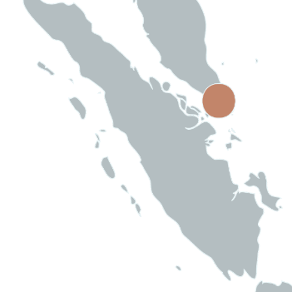
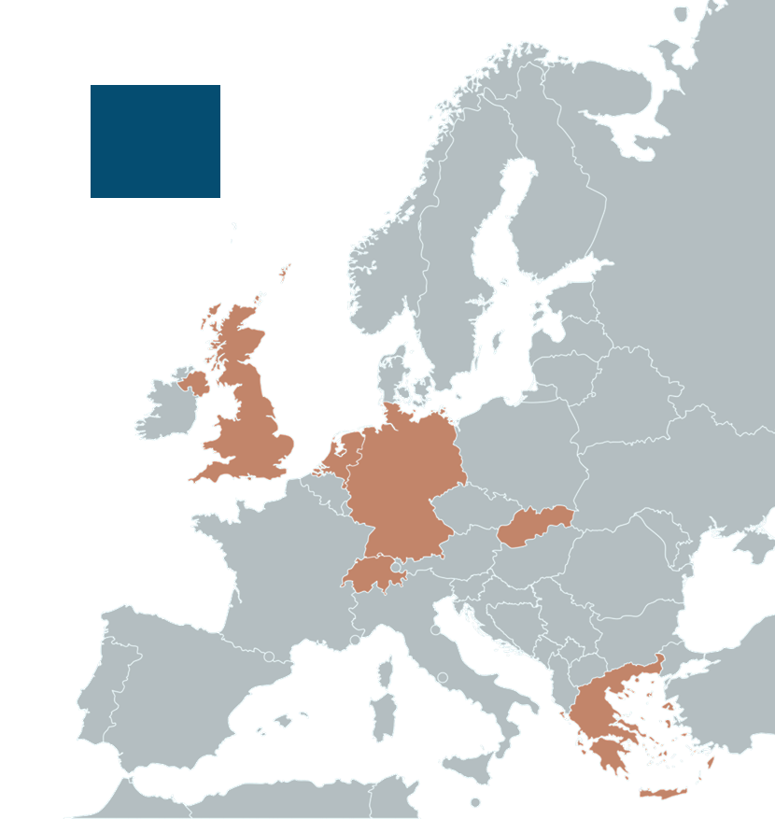
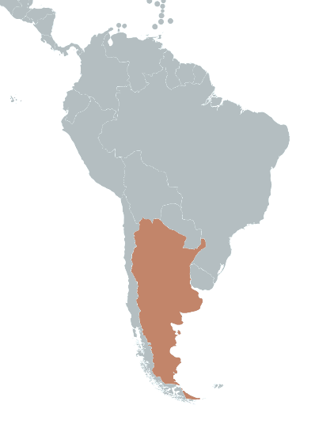
Germany
SUCCESS PTA STUDy 27 Sites in 8 Countries
• Klinikum Hochsauerland (Lichtenberg) • Universitätsklinikum Essen (Rammos)
• Universitätsklinikum Tübingen (Schmehl) • Universitätsklinikum Würzburg (Kickuth) • Krankenhaus Buchholz (Hertting) • GRN Klinik Weinheim (Korosoglou) • SRH Klinikum Karlsbad (Oberacker) • Medizinisches Versorgungszentrum GmbH (Schofer) • LMU Klinikum Großhadern München (Konstantinou) • DIAKO Krankenhaus (Müller-Hülsbeck) • University Heart Center Freiburg (Zeller) • Universitätsklinikum Heidelberg (Böckler)
United Kingdom
• Guy’s and St Thomas’ Hospital (Patel) • The Royal Hospital (Jaffer)
• Frimley Park Hospital (Taylor) • East Surrey Hospital (Heiss) •University Hospital Leicester (Kandiyil)
Singapore
• National University Hospital Singapore (Dharmaraj)
Netherlands
• ETZ Tilburg (Lohle)
Switzerland
• Kantonsspital Aarau (Gissler) • Luzerner Kantonsspital (Rastan)
• HUG Geneva (Glauser)
Slovakia
• Trnava University Hospital (Lebdušková)
Argentina
• Hospital Italiano de La Plata (Pascua)
Greece
• Attikon University Hospital (Brountzos) • General University Hospital of Patras (Katsanos) • Athens Medical Center (Bisdas)

Slide 6
SUCCESS PTA STUDY Patient Flow Chart
Enrolled Patients
N=723
Patients enrolled between:
Feb 2021 and Oct 2023
3 patients withdrew consent and did not approve to keep previously collected study data
Procedure
SELUTION SLRTM DEB
N=720
25 Deaths
39 Withdrawal†
10 Lost to Follow-Up
16 Follow-up Visits Missed
†After 1 year analysis, two withdrawals were later confirmed as deaths
12-month FU
Completed* N=654 (90.8%)
Completed° (inside the window) N=559 (77.6%)
*Patients who completed the 12-month FU visit at anytime or deaths up to 395 days
°Patients who completed the FU visit inside the window (365 ± 30 days) or deaths up to 395 days
25 Deaths‡
5 Withdrawal
17 Lost to Follow-Up
14 Follow Up Visits Missed
‡Two patients died after completing the 2 year follow up within the window
24-month FU
Completed* N=585 (81.3%)
Completed° (inside the window) N=564 (78.3%)
* Patients who completed the 24 FU visit at anytime or deaths up to 790 days
° Patients who completed the FU visit inside the window (730 ± 60 days) or deaths up to 790 days

Slide 7
SUCCESS PTA STUDY Study Overview
Objectives & Design
Global post-market surveillance study of the SELUTION SLR™ DEB (SFA, BTK, Foot)
Collect real world safety and efficacy data on the use of the SELUTION SLR™ DEB
723 patients in 27 sites around Europe, Asia and South America
Primary Endpoint: Clinically Driven Target Lesion Revascularization (CD-TLR) at 12M
Secondary Endpoints:
Device success & Procedure success
Major Adverse Limb Events (MALE) composite endpoint
Death
TLR & TVR - including time to first CD-TLR
Target limb revascularization, thrombosis at the target site and amputation
Change in Rutherford score, ABI from baseline and EQ5D
Follow-up:
Clinical Follow-up: 6 months, 1 year
Telephone Follow-up: 2, 3, 4, 5 years
PI: Michael Lichtenberg, Arnsberg, Germany

Slide 8
SUCCESS PTA STUDY Baseline Patient Characteristics
 | Full Cohort N = 720 | Claudicants N = 534 | CLTI N = 186
Age (years) | 70.7 ± 9.9 | 70.0 ± 9.6 | 72.8 ± 10.3
Male, % | 65.0% | 63.9% | 68.3%
Diabetes Mellitus, % | 37.9% | 33.0% | 52.2%
Insulin Dependent | 13.6% | 9.4% | 25.8%
Previous Intervention*, % (<1 Year) at lesion | 16.6% | 14.8% | 21.5%
Hypertension, % | 85.3% | 84.5% | 87.6%
Hyperlipidemia, % | 76.8% | 77.0% | 76.3%
Cerebral Stroke/TIA, % | 7.1% | 5.6% | 11.3%
Myocardial Infarction, % | 14.9% | 15.0% | 14.5%
Renal Failure/Impairment, % | 16.8% | 12.7% | 28.5%
Current Smoker**, % | 30.3% | 31.8% | 26.3%
Rutherford Class, %
1 | 3.2% | 4.3% | 0%
2 | 21.4% | 28.8% | 0%
3 | 49.4% | 66.7% | 0%
4 | 8% | 0% | 31.2%
5 | 16.5% | 0% | 64%
6 | 1.2% | 0% | 4.8%
Denominators: *718 full cohort; 532 claudicants; **715 full cohort; 529 claudicants
M. Lichtenberg, “First report of the 12-month data from the SUCCESS PTA study: Sirolimus DEB in real-world patients with peripheral arterial disease”, Oral Presentation at Charing Cross Conference 2025

Slide 9
SUCCESS PTA STUDY Baseline Lesion Characteristics
 | Full Cohort (n=822 lesions) | Claudicants (n=604 lesions) | CLTI (n=218 lesions)
RVD (mm) | 5.2 ± 1.5 | 5.5 ± 0.9 | 4.8 ± 2.5
Lesion Length (mm) | 128.4 ± 101.8 | 128.4 ± 102.6 | 128.2 ± 99.6
De novo Lesion, % | 75.1% | 75.2% | 74.8%
Diameter Stenosis (%) | 91.6 ± 11.2 | 91.3 ± 11.6 | 92.5 ± 10.3
Lesion Location*, %
Above the Knee | 81.0% (666) | 85.9% (519) | 67.4% (147)
SFA Proximal | 255 / 666
SFA Mid | 334 / 666
SFA Distal | 346 / 666
POP 1 | 202 / 666
POP 2 | 145 / 666
Other º | 19 / 666
Below the Knee** | 19.0% (156) | 14.1% (85) | 32.6% (71)
POP 3 | 66 / 156
Anterior Tibial Artery | 37 / 156
Posterior Tibial Artery | 15 / 156
TP Trunk | 15 / 156
Peroneal Artery | 8 / 156
Other º | 12 / 156
Total Occlusion, % | 42.1% | 41.7% | 43.1%
MLD (mm) | 1.0 ± 2.1 | 0.9 ± 1.5 | 1.1 ± 3.3
Calcification Grade 3, % | 20.1% | 19.9% | 20.6%
Calcification Grade 4, % | 16.3% | 15.6% | 18.3%
*Above the Knee (ATK): lesions proximal to POP3; Below the Knee (BTK): encompassing lesions distal to POP2. One lesion can cross multiple segments; For ATK: Profunda, iliac, bypass; For BTK: bypass, dorsalis, plantar
**BTK lesions either isolated or combined with inflow (ATK) lesions
M. Lichtenberg, “First report of the 12-month data from the SUCCESS PTA study: Sirolimus DEB in real-world patients with peripheral arterial disease”, Oral Presentation at Charing Cross Conference 2025

Slide 10
SUCCESS PTA STUDY Procedural Characteristics
 | Full Cohort (N = 822 lesions) | Claudicants (N = 604 lesions) | CLTI (N = 218 lesions)
Lesion Preparation | 98.8% (809/819) | 98.5% (593/602) | 99.5% (216/217)
Device Type for Lesion Preparation
POBA | 84.1% (677/805) | 84.9% (502/591) | 81.8% (175/214)
Atherectomy** | 22.2% (179/805) | 22.0% (130/591) | 22.9% (49/214)
Thrombectomy | 3.3% (27/805) | 2.9% (17/591) | 4.7% (10/214)
Scoring Balloon | 4.1% (33/805) | 3.2% (19/591) | 6.5% (14/214)
IVL | 3.8% (31/805) | 3.7% (22/591) | 4.2% (9/214)
Cutting Balloon | 1.7% (15/805) | 1.9% (11/591) | 1.9% (4/214)
Provisional Stenting | 32.0% (263/822) | 33.8% (204/604) | 27.1% (59/218)
Residual Stenosis > 30% | 50.9% (134/263) | 52% (106/204) | 45.8% (27/59)
Flow Limiting Dissection | 48.3% (127/263) | 50% (102/204) | 52.5% (31/59)
Other† | 6.5% (17/263) | 4.9% (10/204) | 11.9% (7/59)
Final Residual Stenosis (%) | 10.0 [0.0-20.0] (821) | 10.0 [0.0-20.0] (603) | 10.0 [0.0-15.0]
Device Success | 99.0% (1296/1309‡) | 99.2% (940/948‡) | 98.6% (356/361‡)
Procedure Success | 97.9% (705/720) | 98.3% (525/534) | 96.8% (180/186)
* Data are presented as percentages % (n/N) or median [IQR]. Values represent total n unless otherwise specified
**Type of atherectomy included 140 rotational, 20 directional, 7 orbital, and 12 were not reported
†Other reasons included calcification (2), recoil (11) and thrombus (4)
‡Total number of devices
Device Success: Successful delivery, balloon inflation, deflation and retrieval of the intact study device without burst below rated burst pressure.
Procedure Success: Device success and residual stenosis ≤ 50% at the end of the procedure.
M. Lichtenberg, “First report of the 12-month data from the SUCCESS PTA study: Sirolimus DEB in real-world patients with peripheral arterial disease”, Oral Presentation at Charing Cross Conference 2025

Slide 11
SUCCESS PTA STUDY 24 Month Freedom From CD-TLR - KM Curves
100%
90%
80%
12 Months
91.4%
24 Months
86.1%
70%
End of follow up window (24+2M)
85.9%
60%
Freedom from CD-TLR (%)
50%
40%
30%
20%
10%
0%
0
365
730
790
Days after Procedure
Overall
720
592
412
321
0
365
730
790

Slide 12
SUCCESS PTA STUDY 24 Month Freedom From CD-TLR – Claudicants vs. CLTI
100%
90%
80%
70%
60%
12 Months
91.5%
91.3%
24 Months
87.0%
83.0%
End of follow up window (24+2M)
86.7%
83.0%
Freedom from CD-TLR (%)
50%
40%
30%
20%
Treatment Group
1-Year
Log-rank p = 0.927
2-Year
Log-rank p = 0.264
10%
Claudicants
0%
CLTI
0
365
730
790
Days after Procedure
Claudicants
534
456
334
258
CLTI
186
136
78
63
0
365
730
790

Slide 13
SUCCESS PTA STUDY 24 Month Clinical Outcomes
Durable Clinical Outcomes Maintained at 730 Days
Clinical Outcomes up to 730 days | Full Cohort (n=720) | Claudicants (n=534) | CLTI (n=186)
Death, % (n) | 7.8% (49/628) | 3.8% (18/478) | 20.7% (31/150)
Major Cardiac Event*, % (n) | 8.2% (50/612) | 6.1% (29/473) | 15.1% (21/139)
CD-TLR, % (n) | 15.3% (90/588) | 14.0% (65/464) | 20.2% (25/124)
Thrombosis, % (n) | 1.2% (7/582) | 0.9% (4/462) | 2.5% (3/120)
Target limb amputation, % (n) | 2.6% (15/588) | 0.2% (1/461) | 11.0% (14/127)
Major target limb amp | 1.5% (9/586) | 0.2% (1/461) | 6.4% (8/125)
Minor target limb amp | 1.0% (6/583) | 0.0% (0/461) | 4.9% (6/122)
MALE**, % (n) | 20.4% (122/597) | 17.6% (82/465) | 30.3% (40/132)
Proportions are defined by the number of eligible patients who completed follow up OR experienced the type of event of interest prior to follow up
*Major cardiac event: MI, stroke, cardiovascular death
**MALE: Severe limb ischemia leading to an intervention to target limb or major vascular amputation

Slide 14
SUCCESS PTA STUDY EQ5D at 24 Month Follow Up (paired analysis°)
° Based on patients who had baseline and 12-month FU available (FU performed inside the window)
No Problem
Slight Problems
Moderate Problems
Severe Problems
Extreme Problems
Baseline
12 Months
24 Months
Baseline
12 Months
24 Months
Baseline
12 Months
24 Months
Baseline
12 Months
24 Months
Baseline
12 Months
24 Months
Mobility
(n=522)
Self-Care
(n=522)
Usual Activities
(n=522)
Pain/Discomfort
(n=522)
Anxiety/Depression
(n=522)
 | Baseline N = 521 | 12-month N = 521 | 24-month N = 521 | Baseline-24M P-value (% change)
EQ-VAS Score | 63.7 ± 18.0 | 70.9 ± 19.2 | 68.0 ± 20.9 | <0.0001*
*Indicates the use of the Wilcoxon Signed-Rank test, otherwise a paired t-test to compare within-group differences​

Slide 15
PRELUDE Study Data in Context: How Does SUCCESS Compare to Other SELUTION Studies
 | SUCCESS PTA Study (n=720) |  | SELUTION SFA Japan¹ (n=134) |  |  | PRELUDE² (n=158)
Study Type | Real-World Registry-Complex Lesions |  | Single Arm Study-SFA + POP Only |  |  | Single Arm Study-High-Risk, Complex Lesions
Age (Years) | 70.7 ± 9.9 |  | 73.8 ± 6.9​ |  |  | 68.5 ± 9.8
Diabetes mellitus, % | 37.9% |  | 60.3% |  |  | 88%
CLTI | 25.8% |  | 2.2% |  |  | 94.1%
BTK, % | 19% |  | 0% |  |  | 63%
PACSS grade 3 and 4, % | 36.3% |  | 26.9% |  |  | 83.9%
Lesion Length (mm) | 128.4 ± 101.8 |  | 127.41 ± 59.73 ​ |  |  | 176.0 ± 138.0
CTOs, % | 42.1% |  | 17.2% (23)​ |  |  | -
RVD (mm) | 5.2 ± 1.5 |  | 4.95 ± 0.93​ |  |  | -
Outcomes (Month) | 12 Mo | 24 Mo | 12 Mo | 24 Mo | 36 Mo | 12 Mo
Primary patency, % | - | - | 87.9% | 83.2% | 81.5%​ | -
FF CD-TLR, % | 91.4% | 86.1% | 97.0% | 95.4% | 93.8%​ | 76.1%
Target Limb Amp, %` | 2.1% | 2.6% | 0% | 0% | 0% | -
FF Target Limb Amp, % | - | - | - | - | - | 91.4%
Soga Y, Iida O, et al. J Endovasc Ther. 2020;27:946-955.
T. Chong, “PRELUDE: 12-month results from Post-procedural Retrospective Evaluation of revascularization outcomes with SELUTION SLR™ sirolimus-coated balloon in patients with peripheral arterial disease”– oral presentation, LINC 2026

Slide 16
SUCCESS PTA STUDY Data in Context – How Does SUCCESS Compare to PTX Registries?
 | SUCCESS PTA Registry (n=720) | IN.PACT Global Registry¹ (n=1406) | Ranger Registry² (n=172) | BIOLUX P-III Registry³ (n=700) | ILLUMENATE Global Registry⁴ (n=317)
RCC 4, % | 8% | 9% | 8% | 11% | 6.2%
RCC 5, % | 16% | 3% | 5% | 21% | 2.4%
RCC 6, % | 1% | 0% | 1% | 6% | 0%
Diabetic, % | 38% | 40% | 35% | 47% | 33.7%
Lesion Length (mm) | 128.4 ± 101.8​​ | 120.9 ± 95.4 ​ | 129 (5-400) | 84.7±73.3 | 75.0 ± 52.7
Severe Calcification, % | 16.3% | 10.2% | 3% | 11.9% | 40.8%
CTO, % | 42.1% | 35.5% | - | 23.8% | 31.3%
BTK involvement, % | 19% | 0% | 0% | 12% | 0%
Provisional Stenting,% | 32% | 21% | 22% | 17% | 17.3%
12 Mo FF CD-TLR, % | 91.4% | 92.8% | 89% | 92.5% | 94.8%
24 Mo FF CD-TLR, % | 86.1% | 83.5% | - | 88.1% | 85.3%
Zeller, et al. Circ Cardiovasc Interv. 2019
Lichtenberg, et al. Journal of Cardio Surg 2018
Tepe, et al. Journ Endovasc Therapy 2020
Schroe, H. Et al. Catheter Cardiovasc Interv 2018

Slide 17
SUCCESS PTA STUDY Conclusions
The SUCCESS PTA is a multi-center, real-world registry with more than 700 patients with claudication and CLTI treated with SELUTION Sustained Limus Release™ Drug-Eluting Balloon (DEB).
In a complex PAD patient cohort, this study of a Sirolimus DEB demonstrated excellent clinical outcomes with no safety concerns.
Positive 24 months outcomes with clinical improvement associated with 86.1% freedom from CD-TLR overall and 83.0% for the CLTI subgroup.
The 24-month results demonstrate consistency and durability of positive results across SELUTION SLR™ DEB trials.

Slide 18
Thank you for your attention

